Slide 1
Team DreamCiti
Xun Yi, Sean, Tyler, Keith, Yi Meng

Slide 2
Table of Contents
01
02
03
04
Problem Statement
Solution Overview
Functionalities
A deep dive
Demo
Live run-through
Future Plans
Future ideas and enhancements

Slide 3
Problem Statement 2
In the banking sector, where complex enterprise applications are crucial, efficient knowledge management is essential to streamline operations and enhance productivity.
The goal of this Proof of Concept (PoC) project is to create a centralized knowledge management system that provides instant answers to users regarding application functionality, architecture, and related aspects. This solution will improve information retrieval efficiency, facilitate better decision-making, and optimize banking operations.

Slide 4
Problem Breakdown
01
02
03
Centralised Knowledge Management
Efficient Information Retrieval
Instant Answers

Slide 5




Introducing CitiDocs
Centralised Knowledge Management
All-in-one database
Efficient Information Retrieval
In-house AI generated answers
Information at your fingertips
Instant Answers

Slide 6
Functionality
Easy upload of data
Web Scraping and PDF Uploading
All-in-one
Instant querying of data
Link to documents given for further reference
Information at your fingertips
AI model to analyse and summarise uploaded documents
In-house AI generated answers
Knowledge centralization. Upload PDF or provide URL to enroll information into VectorDB.
Improve information retrieval efficiency. Query using text and return related paragraphs from various sources.
Augment search using filters (department).
Instant answers. Summarise returned paragraphs for consensus.
Provide links / downloads of reference source.
Upvote or downvote sources to indicate usefulness.
Knowledge management. Delete documents and related paragraphs from all databases.

Slide 7












Technical Overview
Frontend
Backend
Machine Learning
Vector Databases
Neural Networks

Slide 8
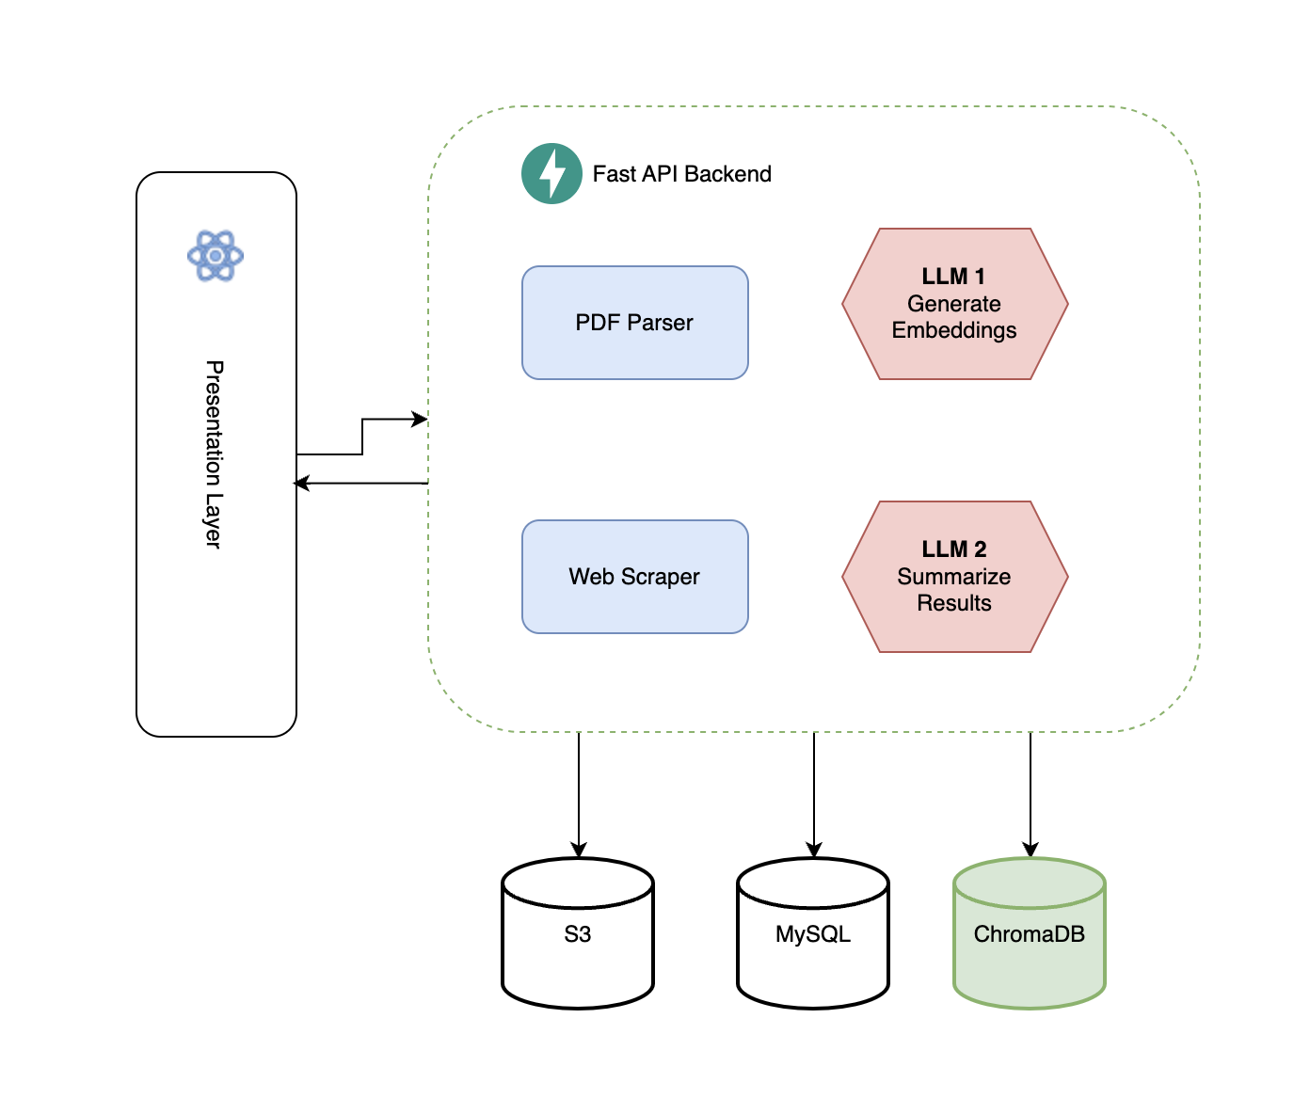
Architecture

Slide 9


Use Case 1 (New Intern)
Use Case 2 (Senior Developer)
Year 3 Intern Tyler
Just joined Citibank as a summer Intern
Has no clue about anything
Senior Dev Sean
10 years of working at Citibank, 20 projects completed
Spends hours everyday explaining his previous project’s documentation to people
No time to spoon-feed intern

Slide 10
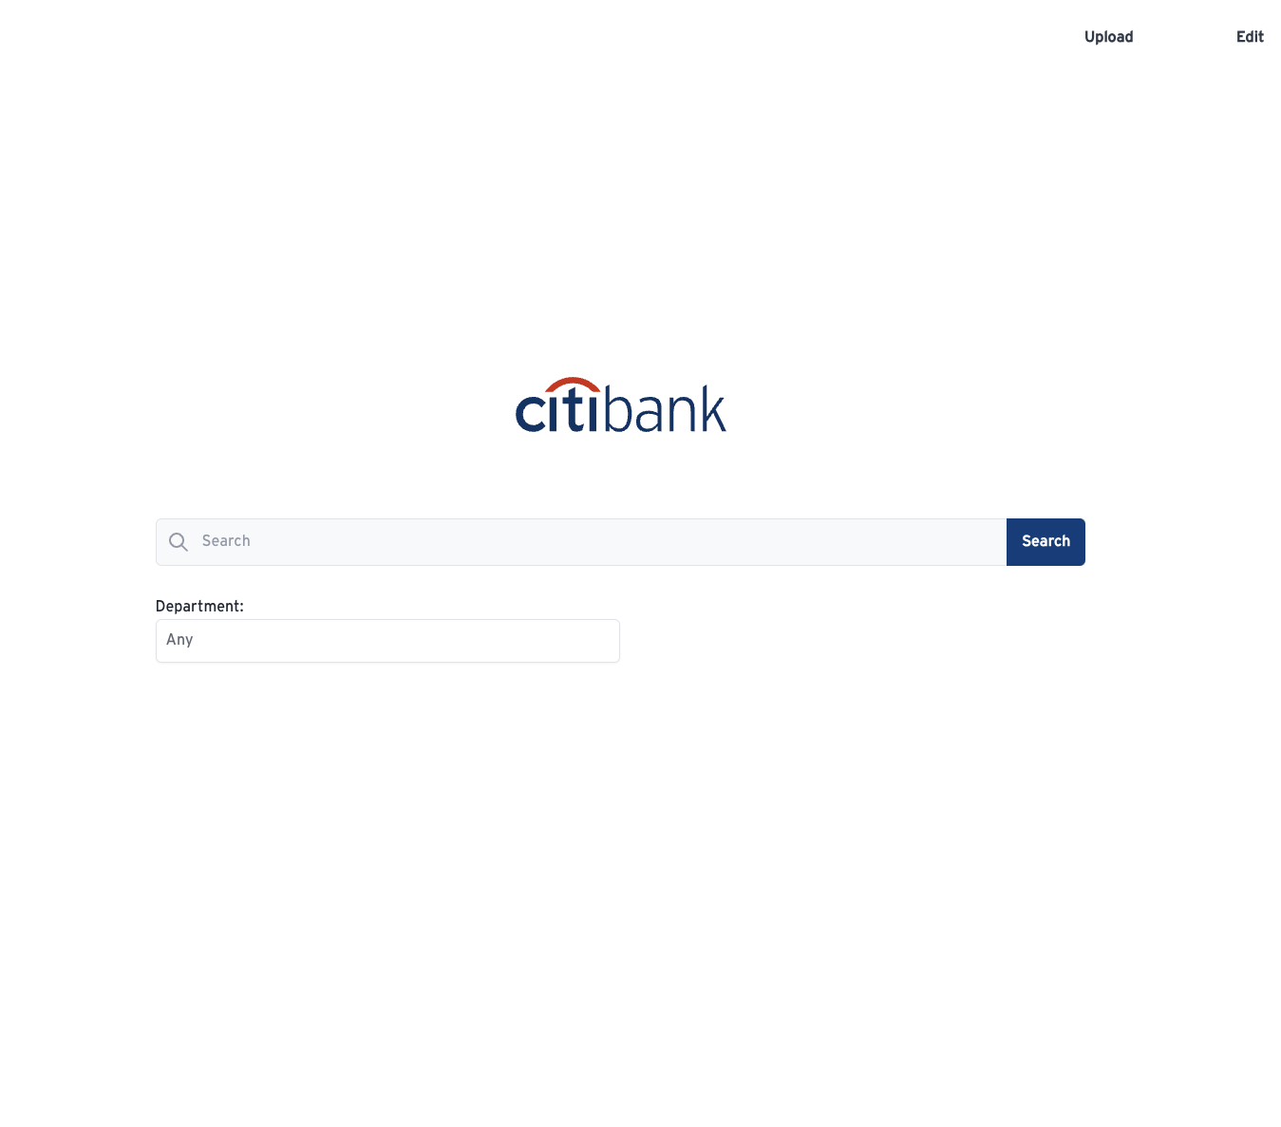
Live Demo

Slide 11



Considerations
Limited external neural networks that stores queries and data
Privacy
Took into account various documentation types
Etc. PDFs, Web Scraping, Image Captioning
Documentation Type
Data collection and querying enhanced by departments
Access
Control
Knowledge centralization. Upload PDF or provide URL to enroll information into VectorDB.
Improve information retrieval efficiency. Query using text and return related paragraphs from various sources.
Augment search using filters (department).
Instant answers. Summarise returned paragraphs for consensus.
Provide links / downloads of reference source.
Upvote or downvote sources to indicate usefulness.
Knowledge management. Delete documents and related paragraphs from all databases.

Slide 12



Future Plans
Varying levels of access for documents and users
Improved User Access Control
Enhance querying of images and diagrams for greater understanding of results
Integrate Captioning of Images
Improved Web Scraper and more file upload extensions
Fine-tuning of in-house AI model catered towards CitiBank’s operations
Data Collection and Querying Accuracy
Knowledge centralization. Upload PDF or provide URL to enroll information into VectorDB.
Improve information retrieval efficiency. Query using text and return related paragraphs from various sources.
Augment search using filters (department).
Instant answers. Summarise returned paragraphs for consensus.
Provide links / downloads of reference source.
Upvote or downvote sources to indicate usefulness.
Knowledge management. Delete documents and related paragraphs from all databases.

Slide 13
Thank You!

